Slide 1
THE ROSARY; A STUDY IN CATHOLIC ART

Slide 2
Concept

Slide 3
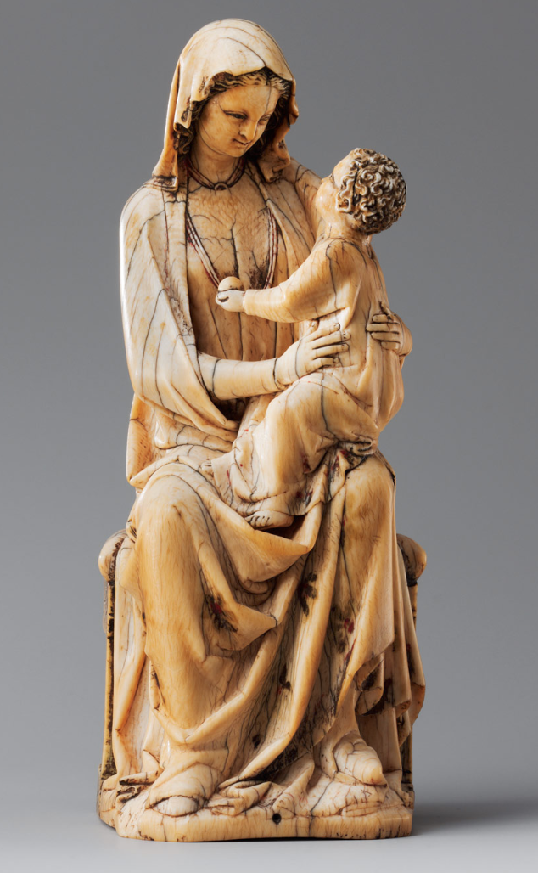
Concept

Slide 4
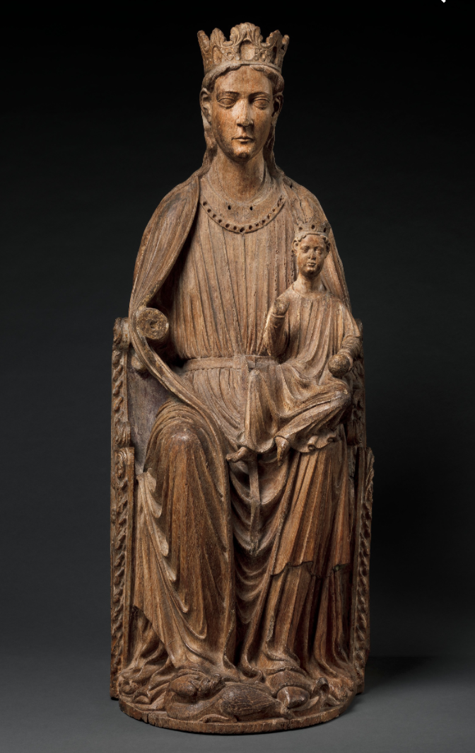
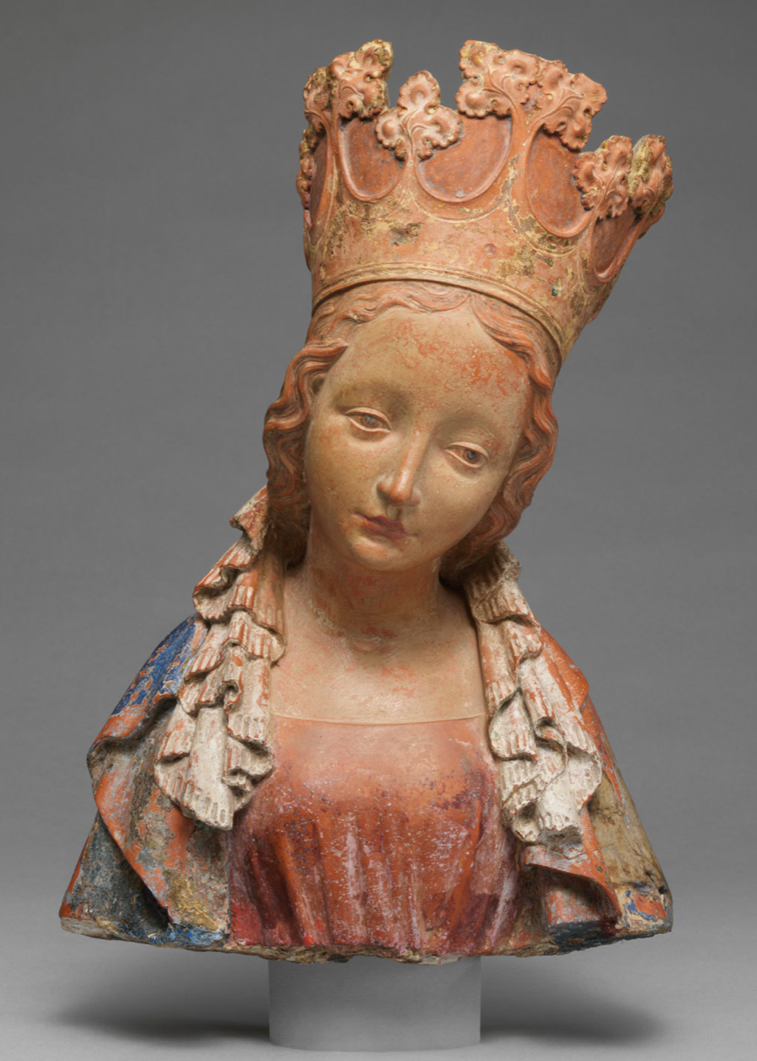
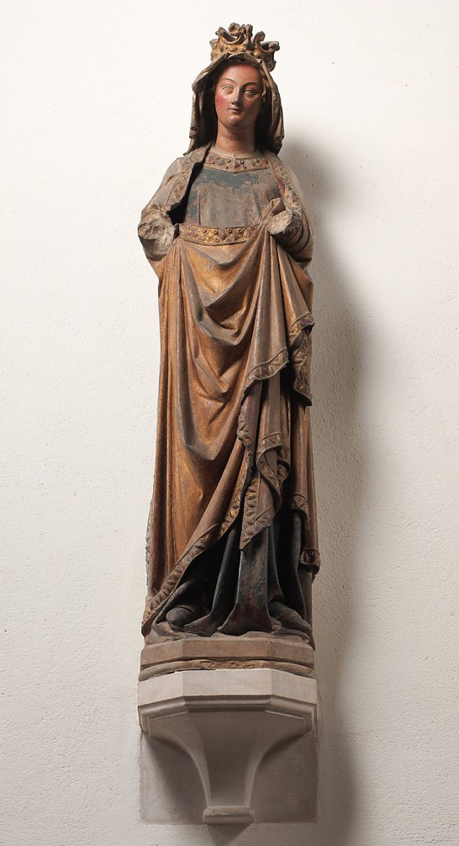
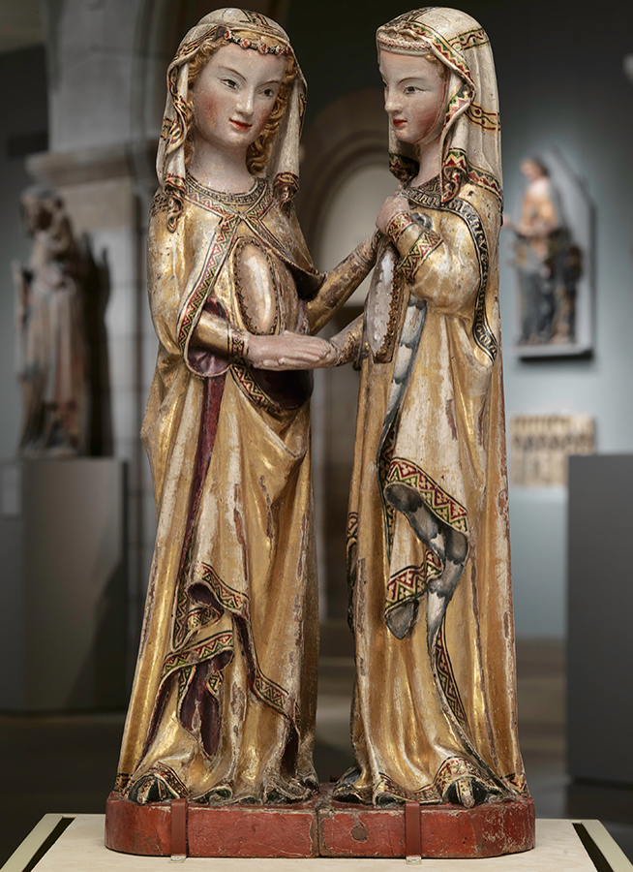
Concept

Slide 5
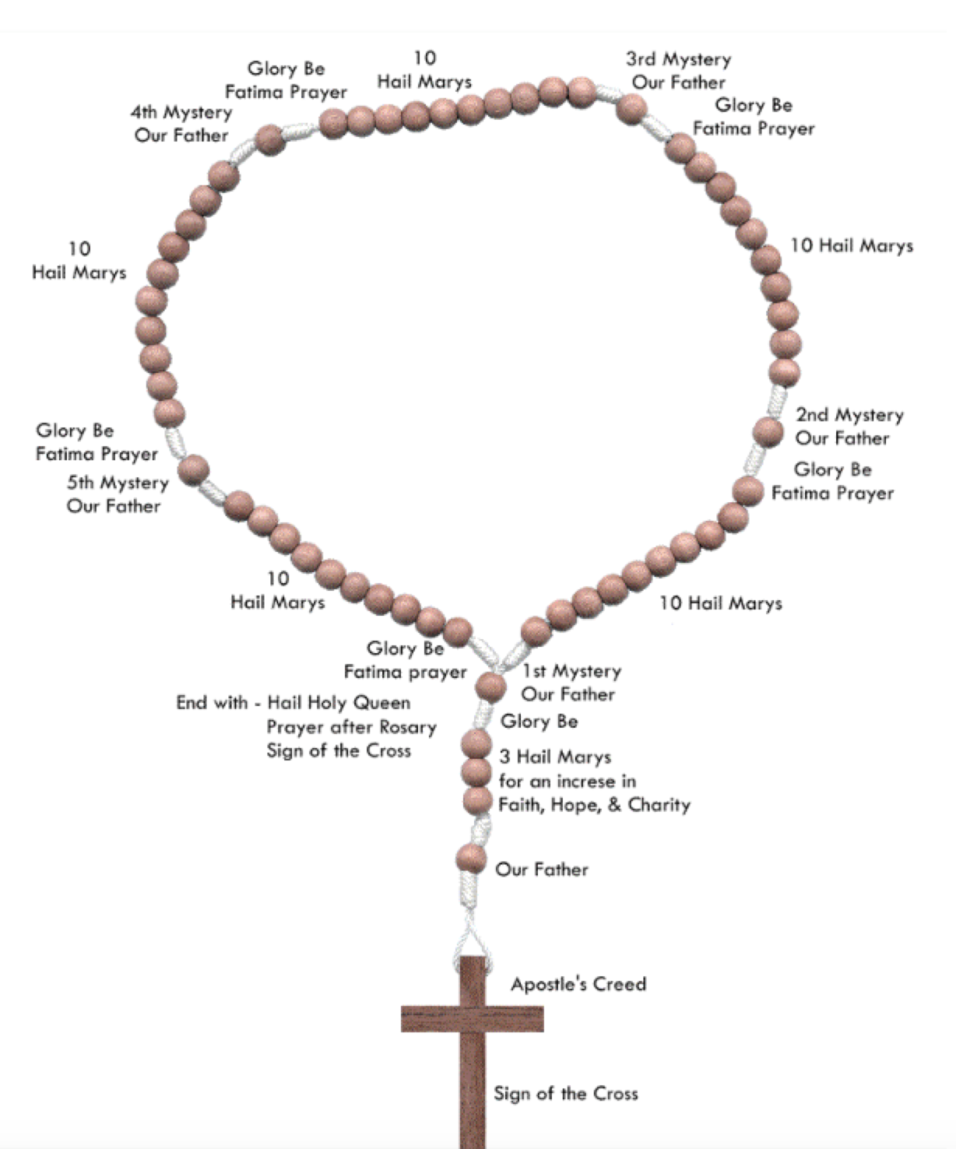
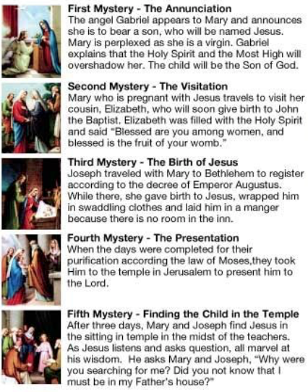
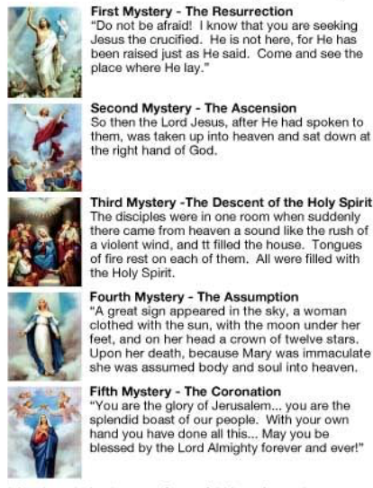
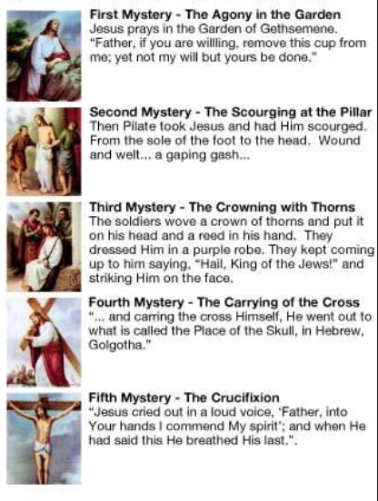
Joyful
Concept
Glorious
1
11
2
12
3
13
4
14
5
15
Sorrowful
6
7
8
9
10

Slide 6
Concept
Goals:
Explore presentation of religious art in secular museums
Reframe presentation into narrative, provides missing context
Means:
Rosary provides the frame & narrative
Find art related to each of the 15 Rosary mystery.
The Met is deep in this art
Questions:
What will we find amongst a large number of objects?
Mediums, periods, origins, etc?

Slide 7
Process

Slide 8
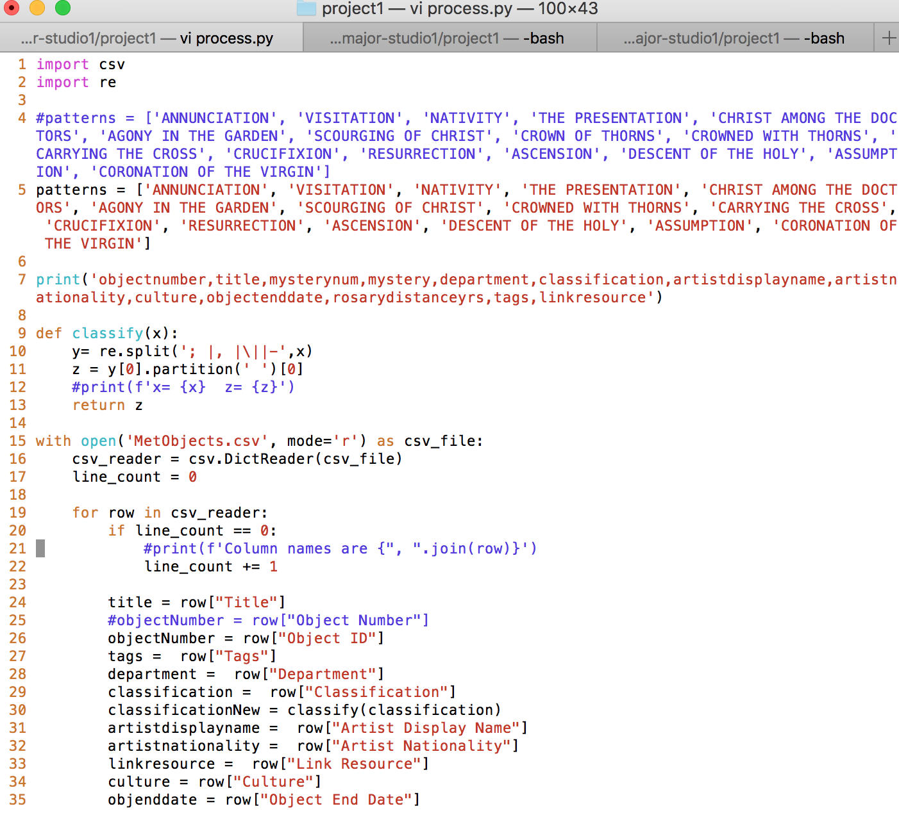
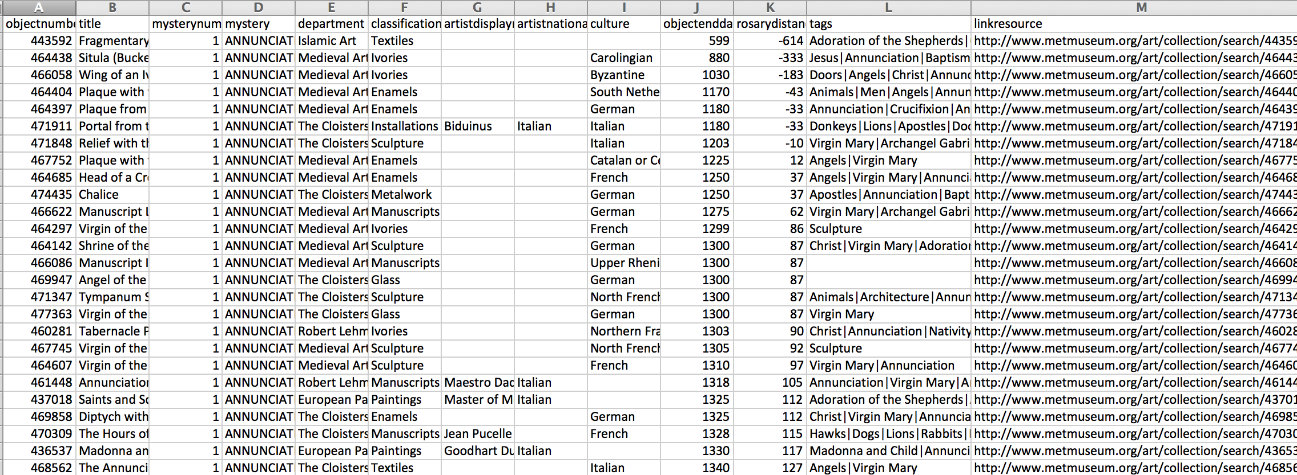
Process
Data Process:
Python script on CSV that performs text search
Result:
~2000 objects
Special Processing:
Rosary Mystery
Close to 1213 (popularization of the Rosary)
Simplification/cleanups of:
Classification
Culture (still working on this)

Slide 9
Data Analysis

Slide 10
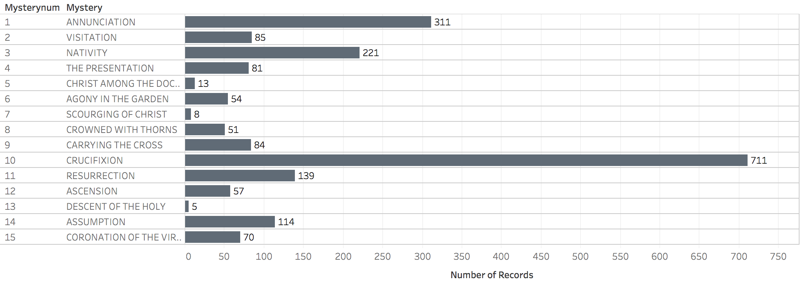
Data Analysis
All mysteries were represented with objects.
Nativity (Christmas) & Crucifixion were most frequent.
Annunciation, Assumption, Visitation were surprisingly frequent.

Slide 11
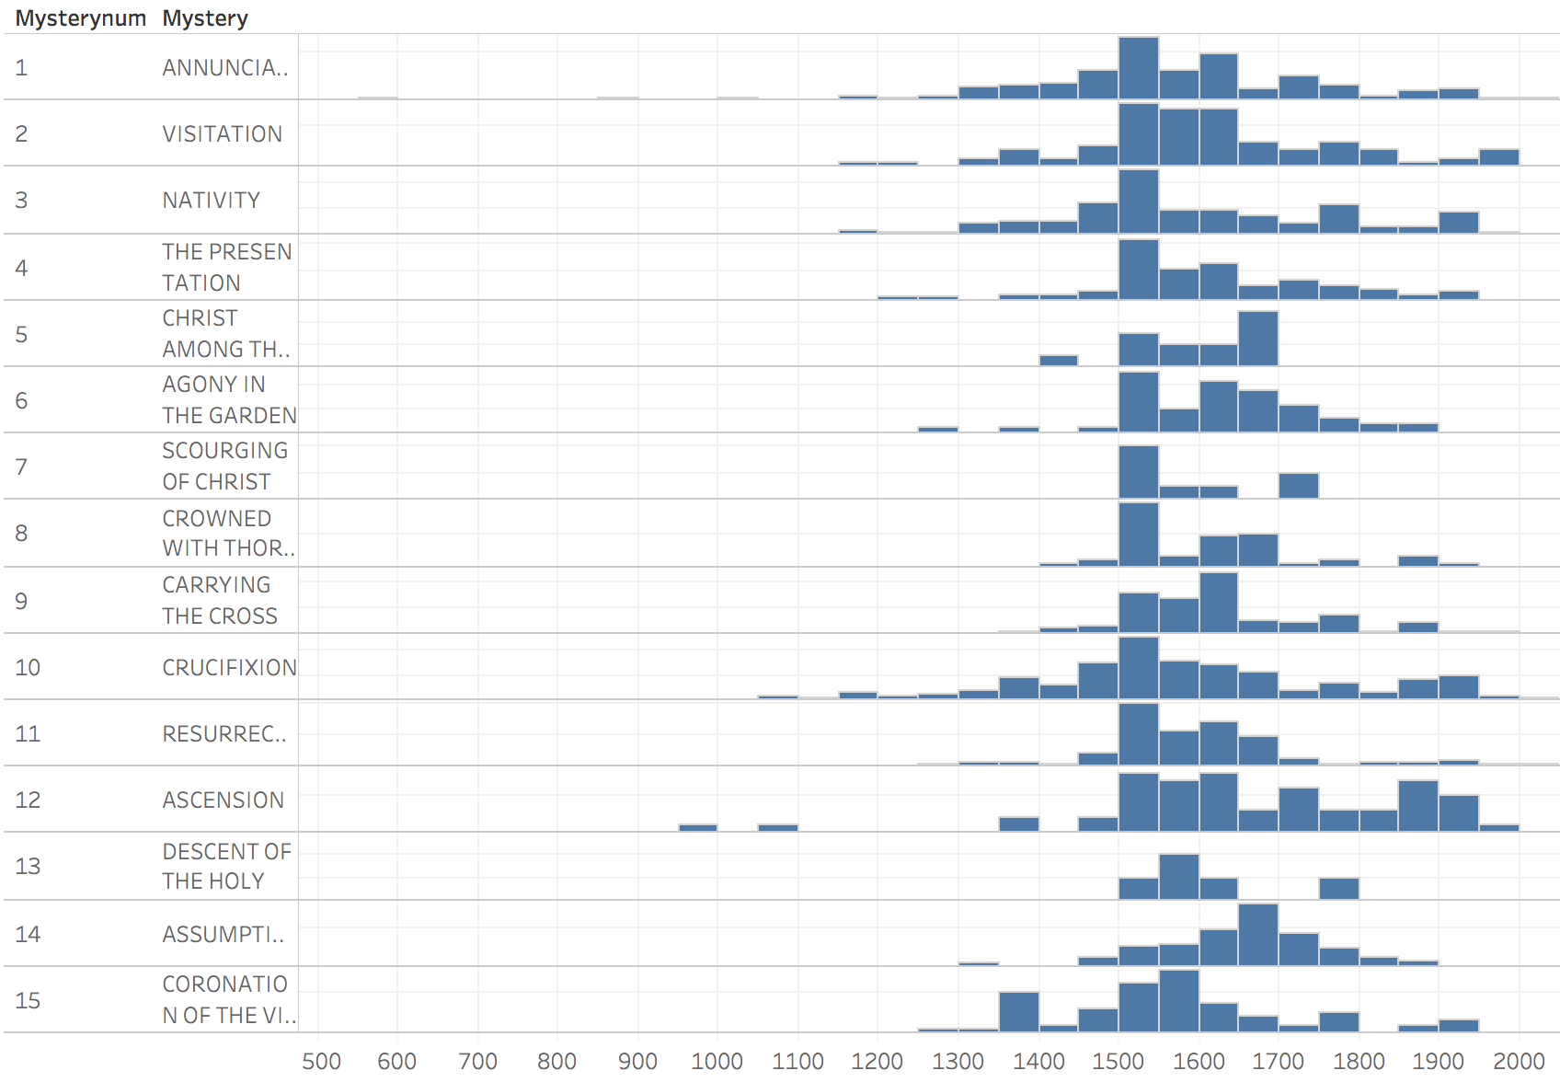
Data Analysis
St. Dominic & rosary popularization
Object Creation Year

Slide 12
Data Analysis
Oldest object department is in Islamic Art
Most recent as of 2005
Modern/secular(?) art
St. Dominic & rosary popularization
Sustained interest
Into 20th century?
Declining interest?
Sustained interest
Into 20th century?
Object Creation Year

Slide 13
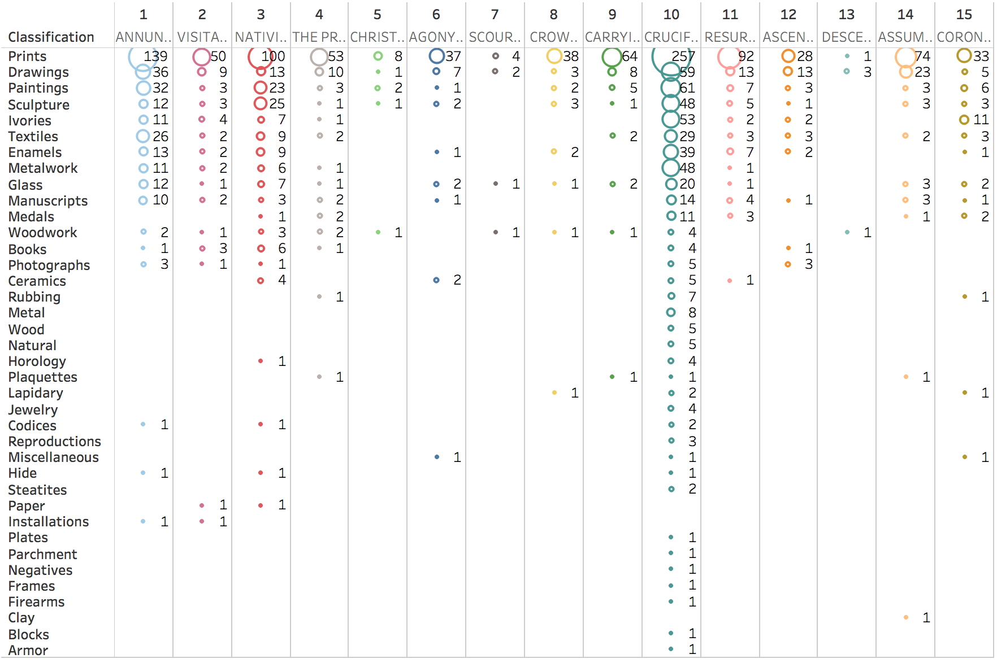
Data Analysis
Classification

Slide 14
Data Analysis
Data Elements
Aggregates
Count of objects by Mystery
Diversity of objects, e.g. the number of different classifications
Max by Culture (e.g. Italian, German)

Slide 15
Design

Slide 16
Design

Slide 17
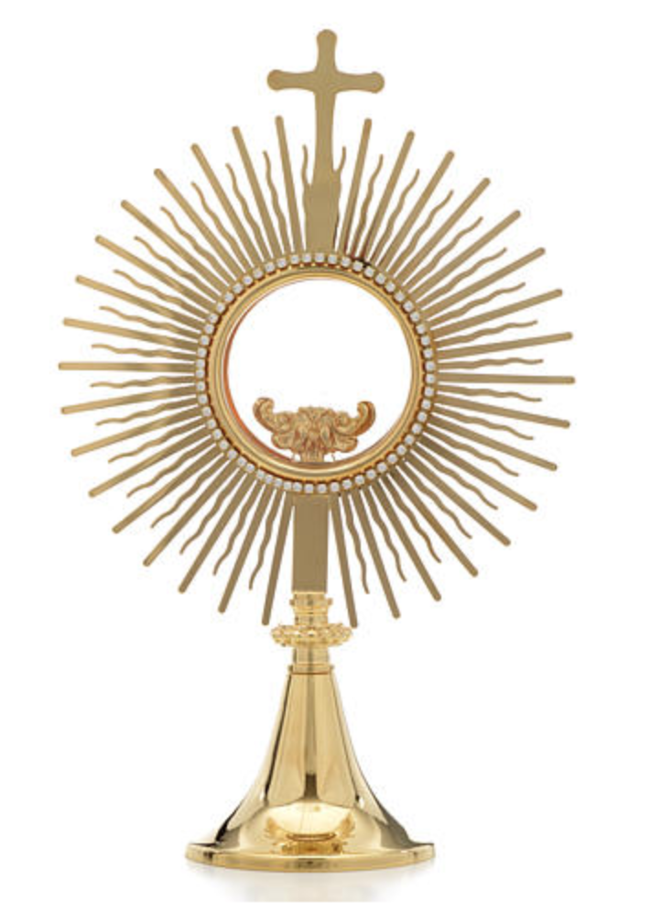
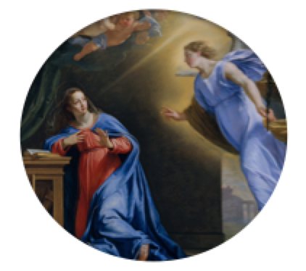
Design

Slide 18
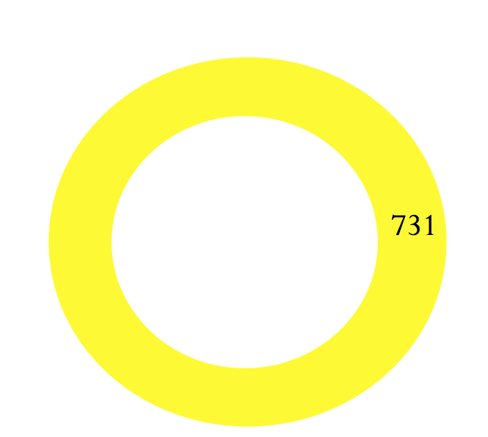
Design
The Annunciation

Slide 19
Design
Paintings
Drawings & Prints
Sculpture
Others
0
2019
The Annunciation

Slide 20
Design
Paintings
Drawings & Prints
Sculpture
Others
0
2019
The Annunciation
Integration of culture/origin country?
Top culture?
More aggregated view
Integration of interesting details (mouse over?)

Slide 22
?

Slide 23
Typeface
Pffeffer Mediaeval
THE ROSARY; A STUDY IN CATHOLIC ART
Perpetua
THE ROSARY; A STUDY IN CATHOLIC ART

Slide 24
End

Slide 26
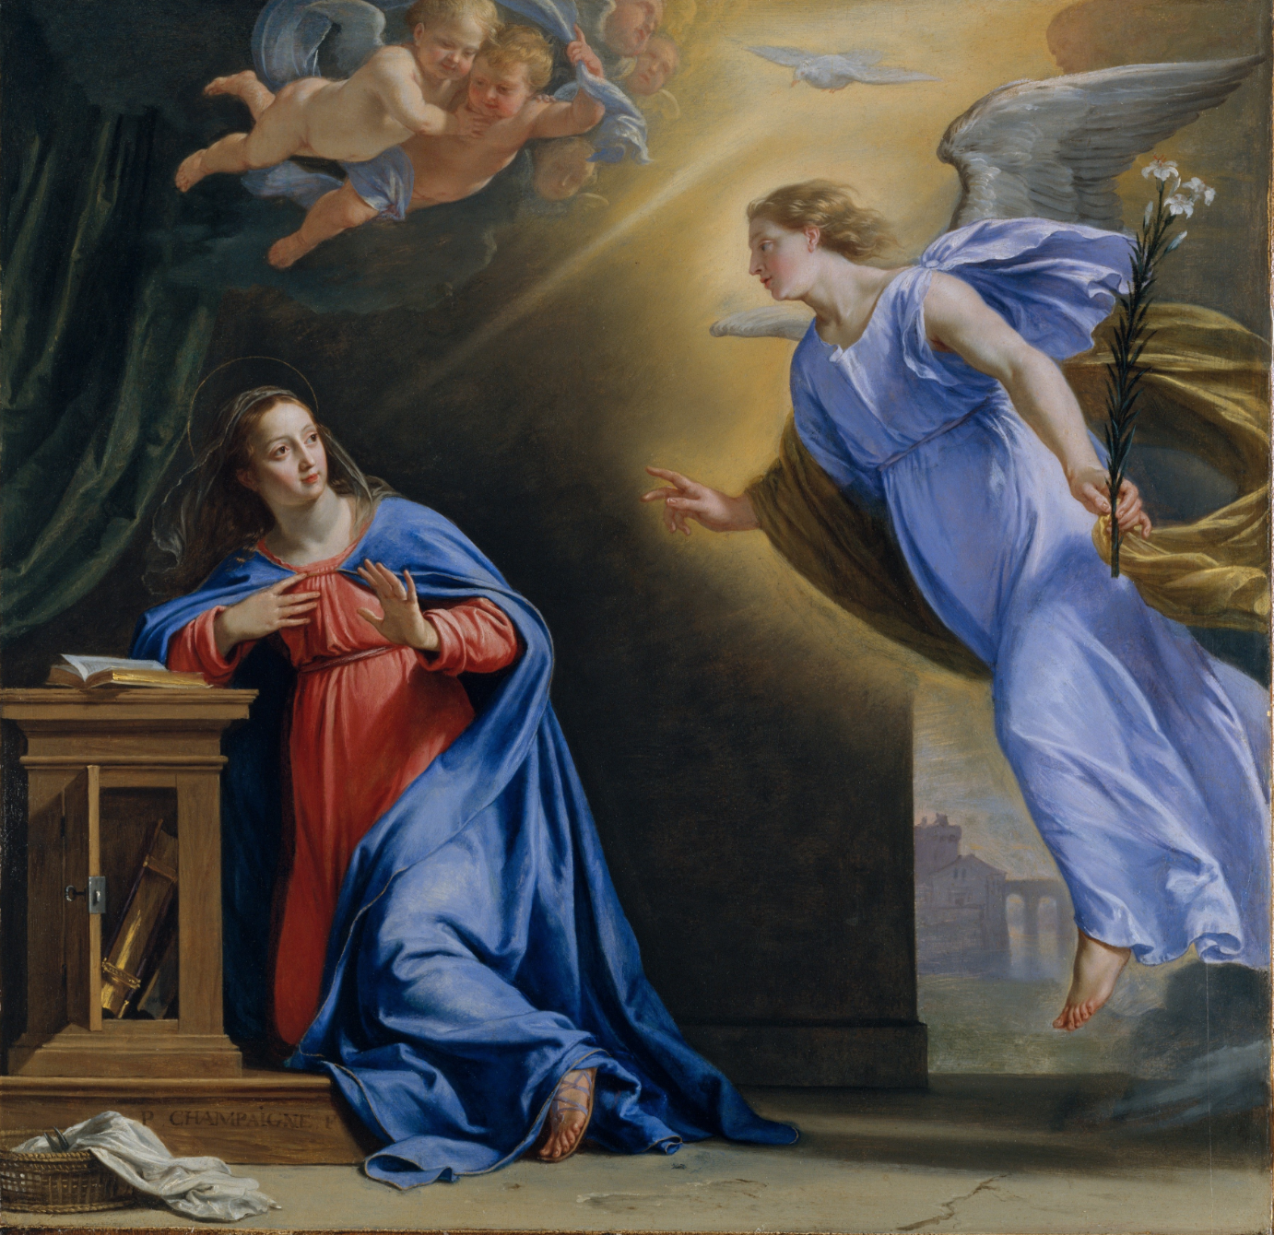

Slide 27
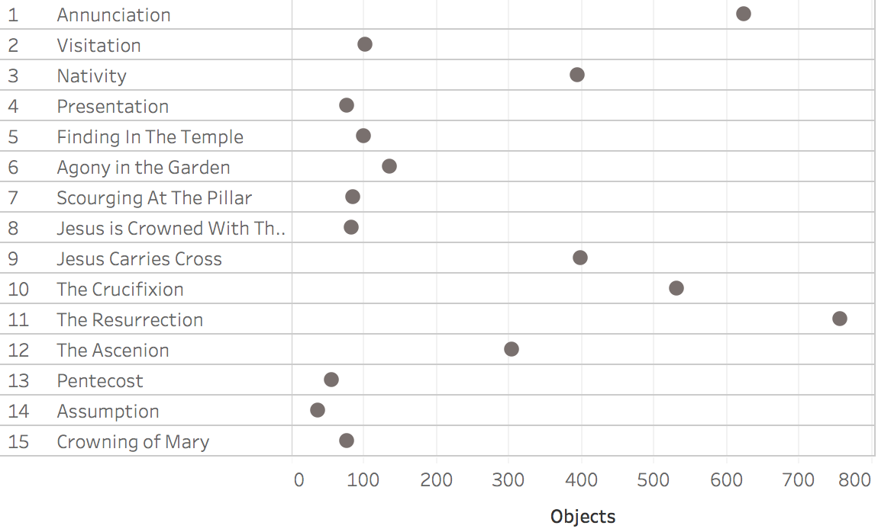
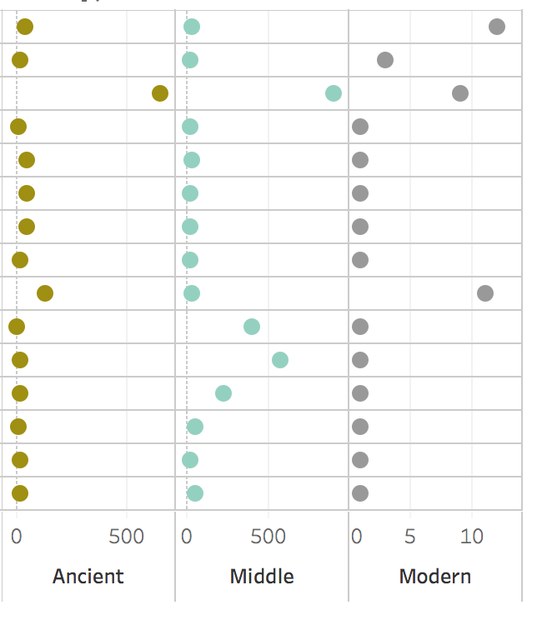
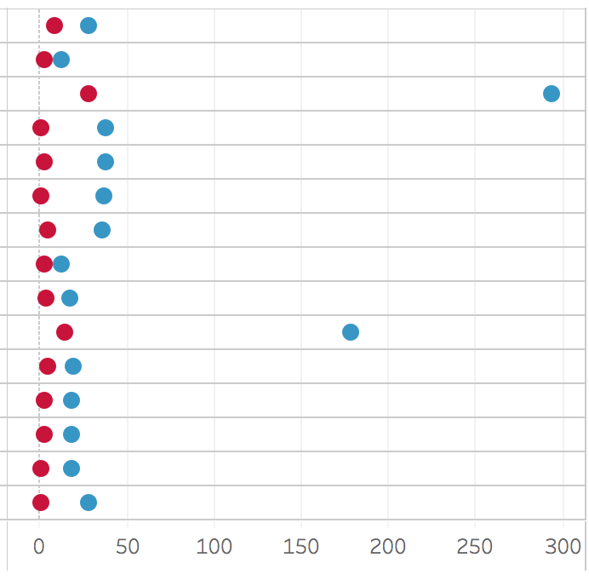
Metropolitan Museum of Art
The Rosary: Catholic Art Over Two Millennia
Objects
Paintings vs. Sculpture
Time Period
Notes: This ended up being a rough conceptualization. The hardest part was coming with a lens across the Met database.
The idea is to identify artwork associated with a popular devotion. Some Of the artwork would pre-date the popularization of the devotion.
Right, now assumes data would be aggregated and available in a summarized form.
Dot plots show simple counts of objects by category. Ordering is the order they are normally prayed. Expectation would be certain mysteries
Are hugely popular subjects such as Nativity(Christmas) but what about the others?
Problems in this sketch: arbitrary color, a bit boring in presentation, wasted space where these notes are.
Improvement ideas: running total over time when art was created. Alternatives to dot plots. Perhaps unit chart. Or more vertical orientation.

